Slide 1
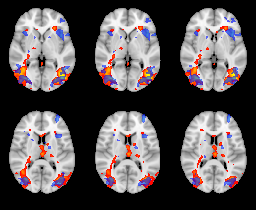
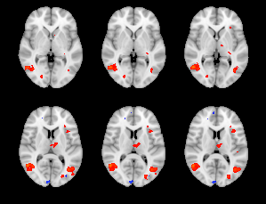
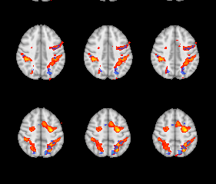
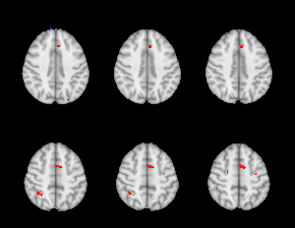


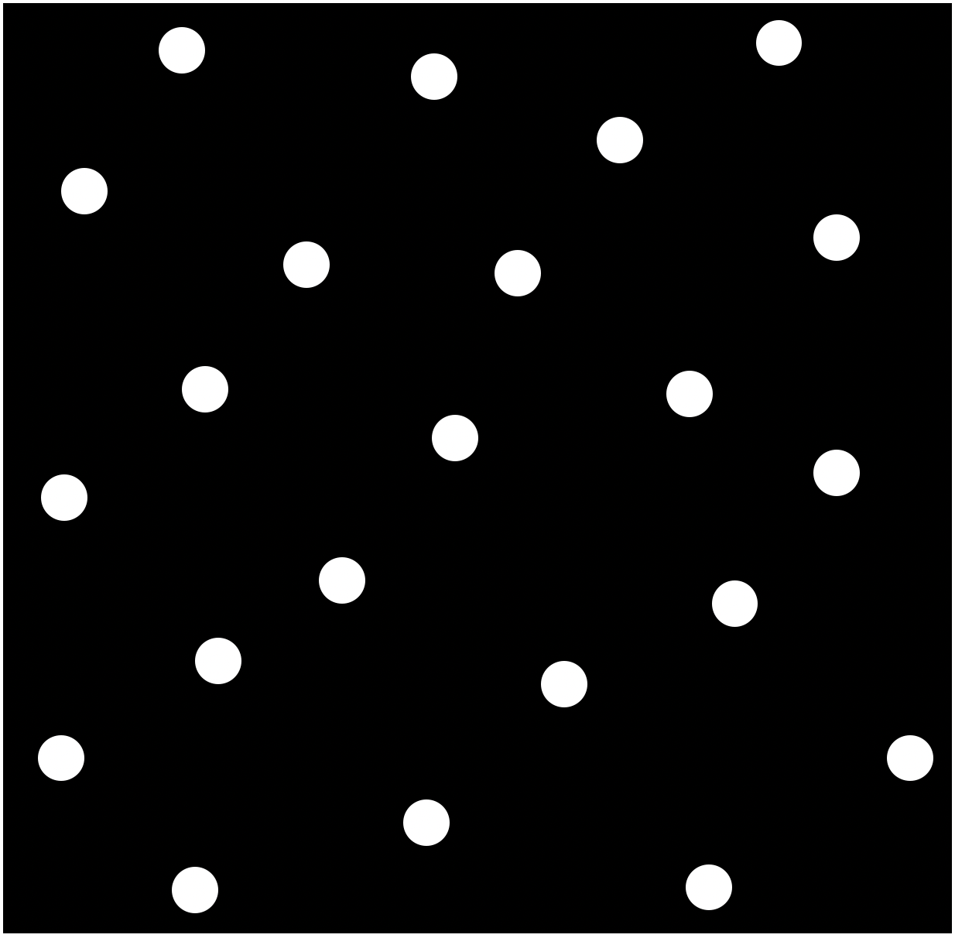
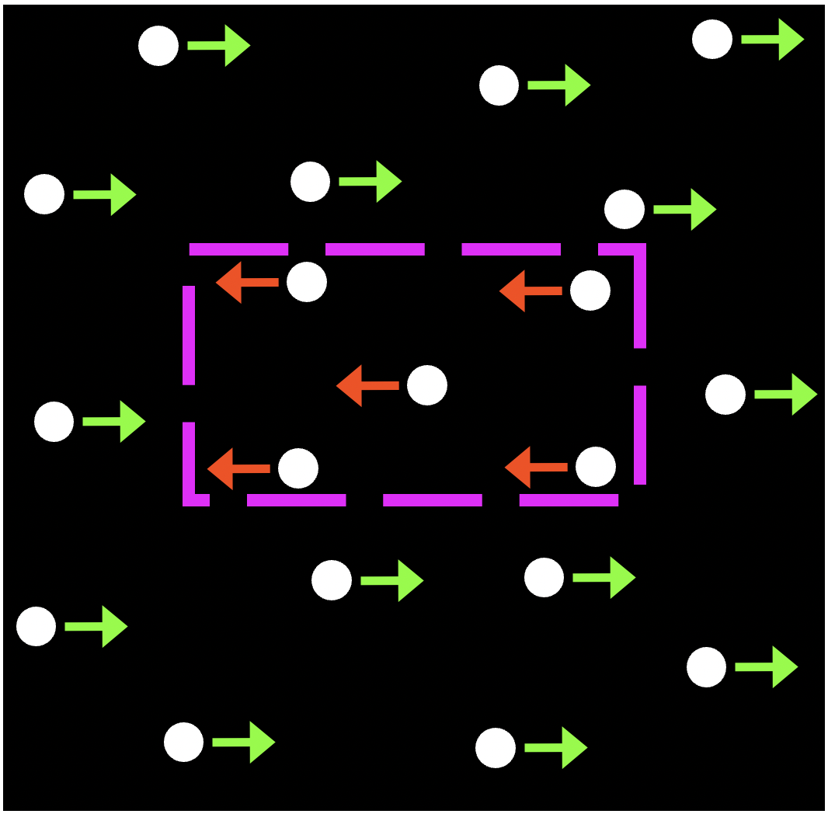
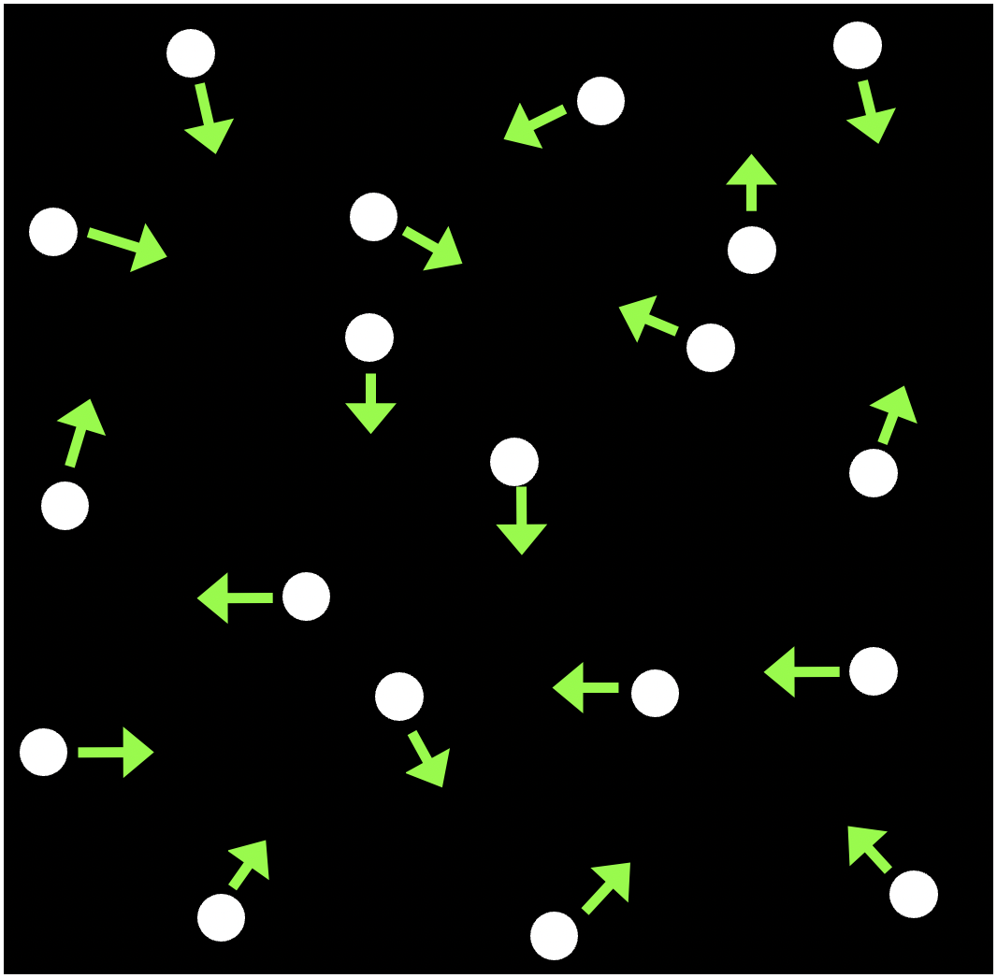
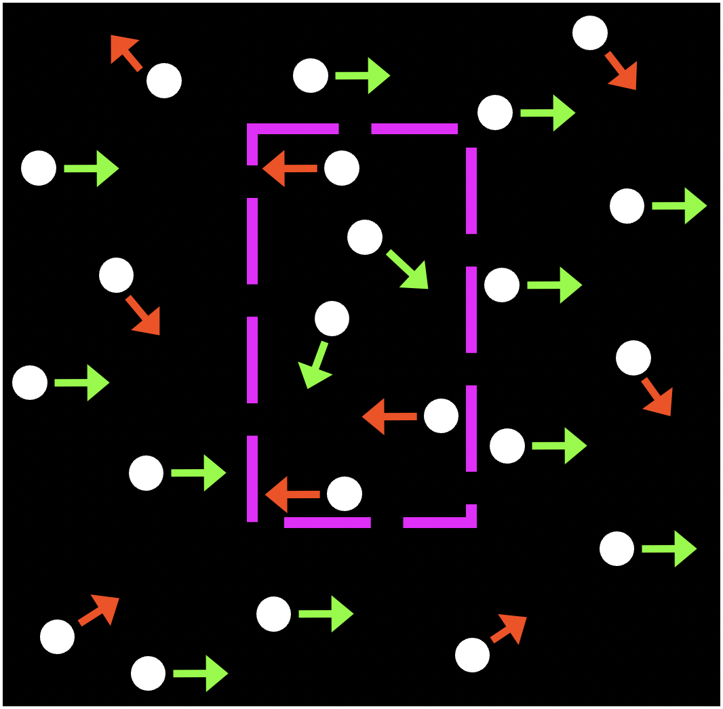
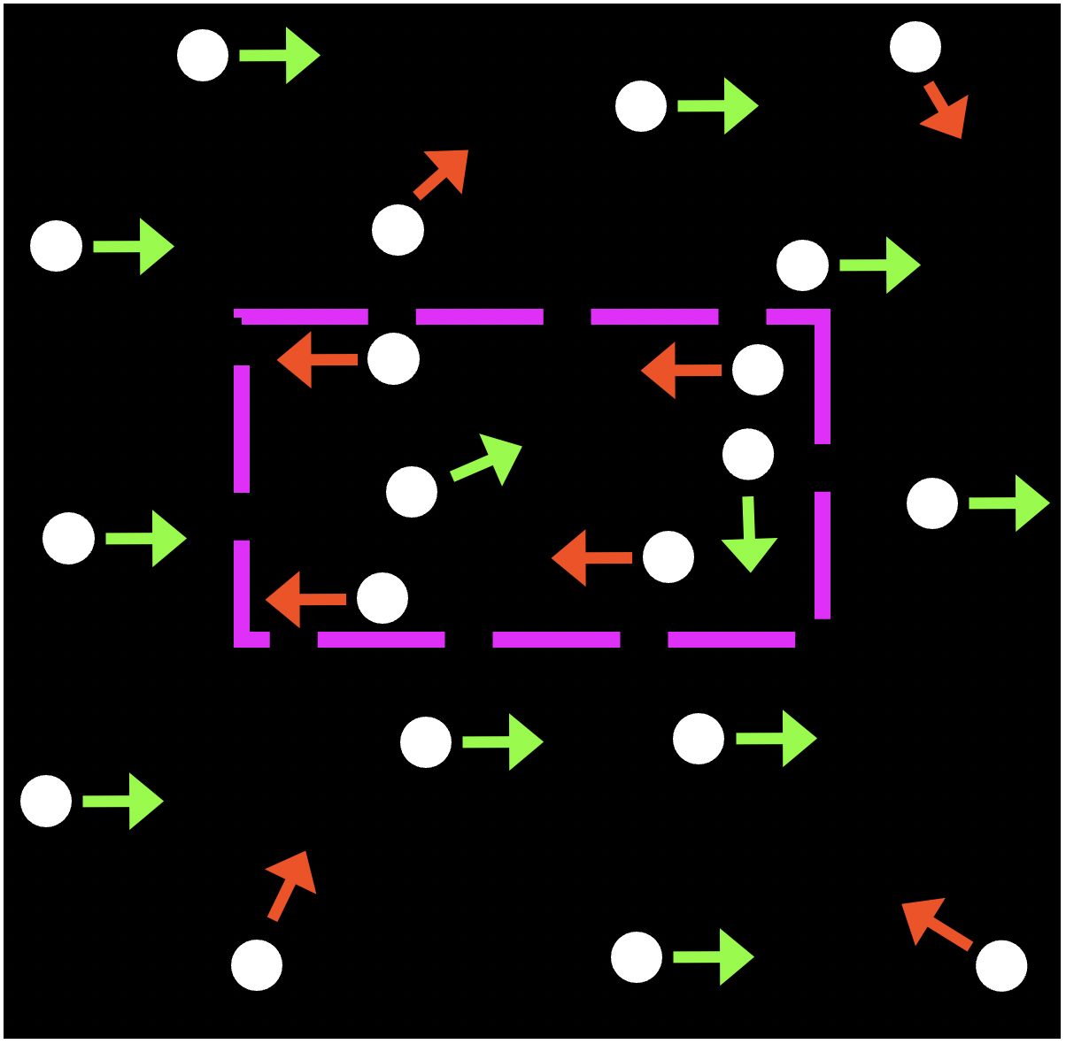
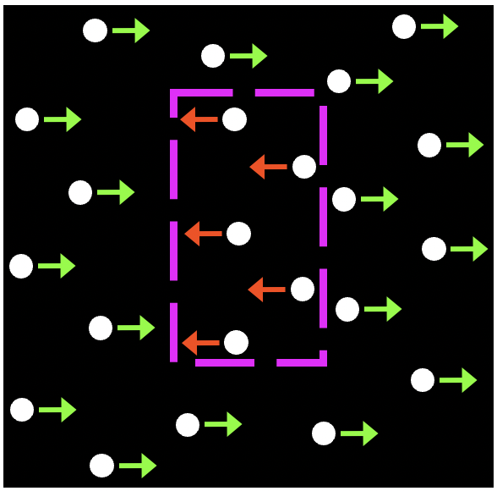
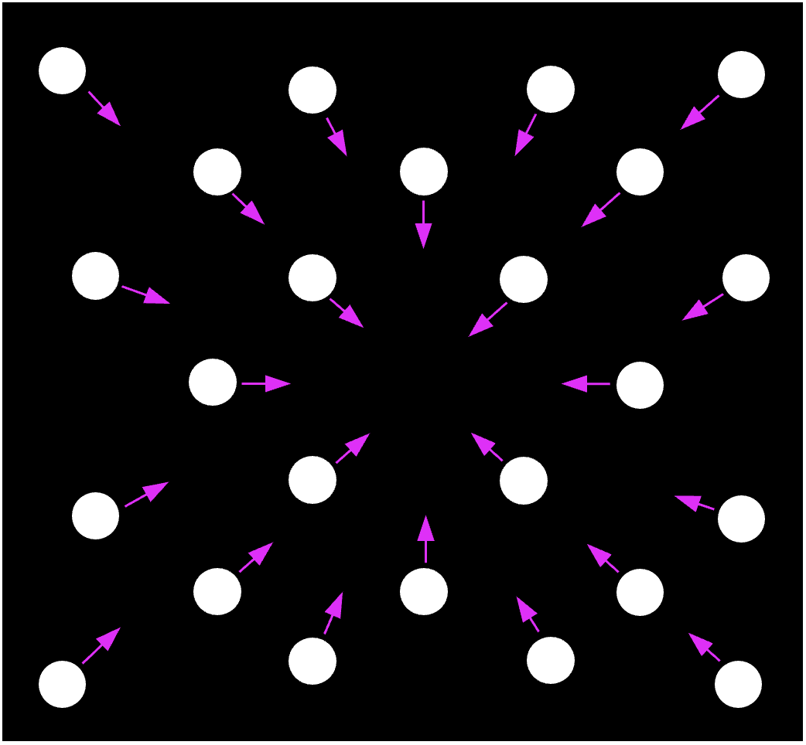
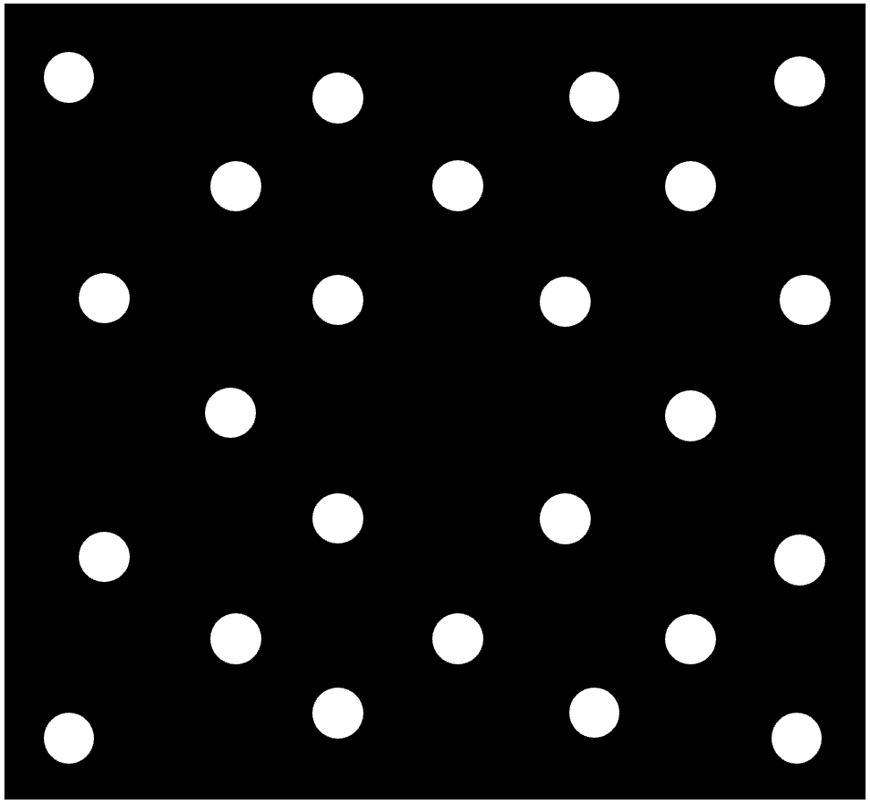

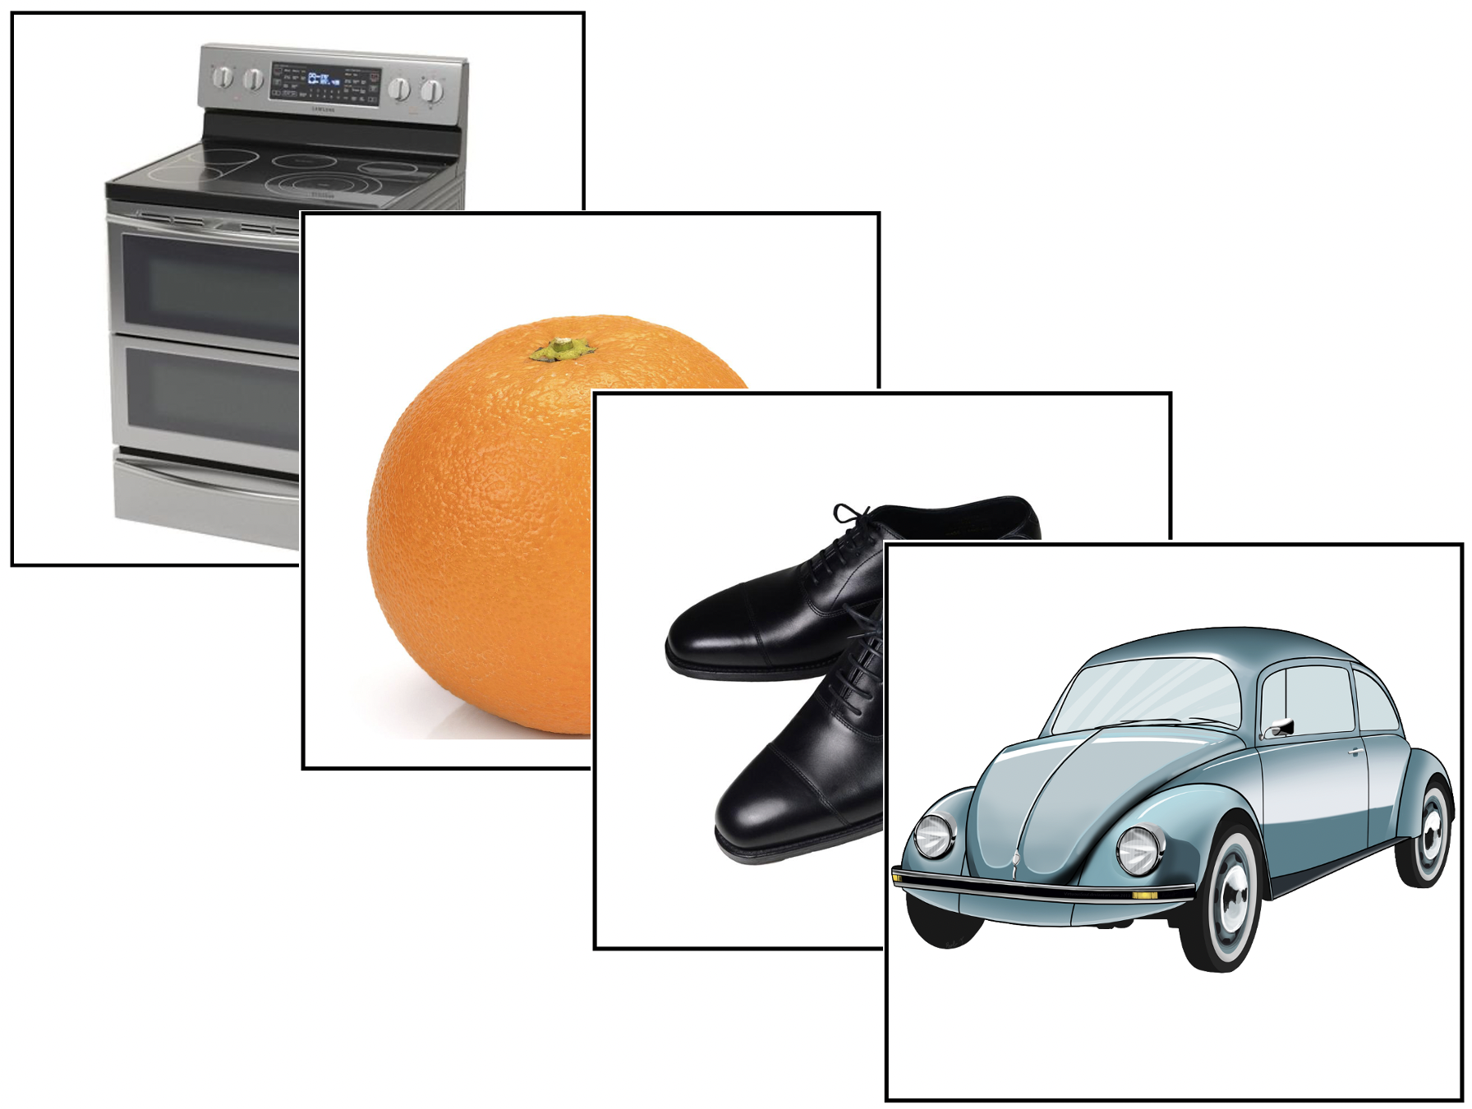
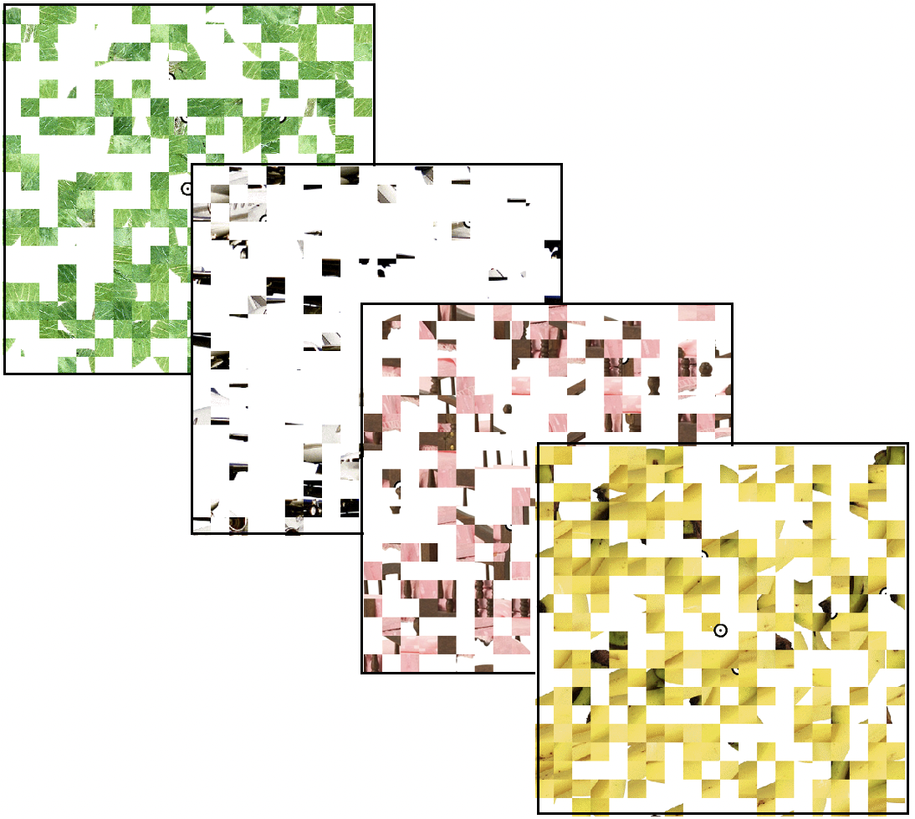

Neural correlates of the motion-defined form deficit in the fellow eye of adults with amblyopia
Akosua Asare, Nolan Chem, Hee Yeon Im, Deborah Giaschi
The University of British Columbia
Background
Analysis
Amblyopia (lazy eye) is a common developmental visual disorder defined clinically as reduced visual acuity in one eye that cannot be immediately corrected with lenses.
Amblyopia also disrupts motion perception even in the clinically-unaffected fellow eye.^{1,2}
Psychophysical studies have reported deficits for slow but not faster speeds of motion,³ and these deficits persist after standard treatment with occlusion therapy.⁴
Evidence from electrophysiological and psychophysical studies suggests that slow and medium-to-fast speeds of motion are processed by different mechanisms.⁵
We have shown previously that a motion-defined form task is very sensitive to disruption by amblyopia.^{2,3}
Both slow and medium speeds of motion-defined form activate V5/MT+ and LOC in adults with normal vision.⁵
Topup data were collected with reversed phase-encode blips to correct for distortion, and applied to the functional data using FSL.^{6,7}
Data analysis was carried out using FMRI Expert Analysis Tool (FEAT) version 6.00.
First-level GLM analysis was applied to the whole brain, and mixed-effect group analysis was conducted to evaluate contrasts for medium > random and slow > random motion.
Significant activations were determined using cluster thresholding (z > 3.1) and family-wise error rate of α = .05.⁸
Functional localizer runs for each participant were used to define individual ROIs for V5/MT+ and LOC, and to extract parameter estimates (beta weights).
Results
Behavioral performance
Task accuracy during scan
Purpose
 |  | Amblyopia | Control | p-value
Medium speed | Near threshold coherence | .73 | .68 | p= .33
 | High coherence | .95 | .99 | p= .15
Slow speed | Near threshold coherence | .82 | .63 | p= .02*
 | High coherence | .86 | .98 | p= .07
To determine the effect of speed on the cortical regions activated during a motion-defined form task in adults with amblyopia.
Methods
Whole-brain maps (Motion-defined form, near threshold coherence)
Participants
9 adults with normal vision and 5 adults with amblyopia (21 – 39 years old, M= 27.3, SD= 6.6)
Controls
Amblyopia
Medium speed:
Bilateral activation in V5/MT+, LOC, posterior occipital (POC) and posterior parietal (PPC) cortex in both groups
Slow speed:
Bilateral activation in V5/MT+, LOC and PPC in control group
Little activation in amblyopia group
Stimuli and fMRI task
Motion-defined rectangles created by moving dots coherently in one direction inside the rectangle and in the opposite direction outside the rectangle with medium (5 deg/s) or slow (0.1 deg/s) dot speeds.
MT
MT
POC
POC
MT
MT
POC
POC
Proportion of dots moving in the same direction was adjusted using a 2-down, 1-up staircase method to determine coherence threshold for discriminating the orientation of the rectangle (vertical or horizontal) for each speed in each participant.
Stimuli were viewed through the fellow eye in the participants with amblyopia or through a matched eye in the controls.
LOC
LOC
MT
MT
LOC
LOC
MT
MT
PPC
PPC
PPC
PPC
1.96
PPC
PPC
PPC
PPC
3.68
z (cluster-corrected)
Medium speed > Random motion
Slow speed > Random motion
Motion-defined form fMRI block design
Each participant completed 2 or 3 functional MRI runs. Each run¹ was made of 3 cycles, with 7 blocks (12 s each; pseudorandom order) and 8 trials per block
Button press to indicate orientation of rectangle on each trial (accuracy determined)
Region-of-interest analysis
Repeated-measures ANOVA revealed:
No group difference at medium speed
At near threshold coherence:
Amblyopia group showed less activation than control at the slow speed
Amblyopia group showed less activation for slow speed than medium speed
p= .009
Stationary
dots
Medium speed
Slow speed
Medium speed
Slow speed
Slow speed
Medium speed
High
coherence (1.0)
Random
motion
Near threshold coherence
Near threshold
coherence
High
coherence (1.0)
Random
motion
x3
p= .049
one cycle
Motion-sensitive area V5/MT+ localizer
Passive viewing
12 s 12 s
Object-selective area LOC localizer
Button press when an image appears twice in a row
Expanding & contracting dots
vs
Stationary dots
x6
Similar to the effect seen in V5/MT+, both groups showed similar activation at the medium speed
Amblyopia group showed a trend toward less activation than controls at the slow speed for both coherence levels
Intact images of objects
vs
Scrambled images
x5
Conclusions
14.4 s
14.4 s
The speed-tuning of the behavioral deficit in motion-defined form perception in the fellow eye in amblyopia is evident in task-based fMRI activation maps.
Group differences were restricted to the slow speed, and were largest in V5/MT+, but also evident in LOC and PPC.
Regions of the dorsal and ventral visual streams appear to underlie this deficit.
Data acquisition
GE 750 3.0 Tesla scanner; 32-channel Nova Medical head coil; multiband EPI sequences
T1-weighted 3D anatomical whole-brain image: TR = 8 ms, TE = 3 ms, 256 x 256 matrix, 1mm³ voxel size, 176 sagittal slices
T2-weighted 4D functional images: TR = 600 ms, TE = 30 ms, 96 x 96 matrix, 3 mm³ voxel size, 38 interleaved axial slices
Motion-defined form: 440 volumes per run
V5/MT+ and LOC localizers: 240 volumes each
References
Meier K, Giaschi D (2017) Invest Ophthalmol Vis Sci 58:1779-1800
Ho CS, Giaschi D, Boden C, Dougherty R, Cline R, Lyons C (2005) Vis Res 12:1615-1627
Hayward J, Truong G, Partanen M, Giaschi D (2011) Vis Res 20:2216-2223
Giaschi D, Chapman C, Meier K, Narasimhan S, Regan D (2015) Vis Res 114:122-134
Meier K, Partanen M, Giaschi D (2018) Perception 6:660-683
Andersson J (2003) NeuroImage 20:870-888
Smith M et al. (2005) NeuroImage 23:208-219
Worsley KJ (2001) in Functional MRI: An Introduction to Methods OUP 14:251-270.

